Slide 1

OPTIMIZATION OF UNMASKING CYBERBULLIES ON TWITTER
VEMU INSTITUTE OF TECHNOLOGY
Chittoor-Tirupati National Highway, P.Kothakota, Chittoor (Dt.), AP - 517112
Present By
P. V. SUDHEER (184M1A0584)
N. SIVA PRASAD (184M1A0576)
V. ANIL KUMAR (184M1A05A7)
V. GNANESWAR (184M1A05B3)
Under the Guidance of
Mr. P. Murali, M.Tech
Assistant Professor, Dept of CSE
Department of Computer Science & Engineering
2018-2022

Slide 2
CONTENTS
1. Abstract
2. Introduction
3.Literature Survey
4. System Analysis
4.1 Existing System
4.2 Proposed System
4.3 Softwares and Hardware Requirements
5. System Design
5.1 System Architecture
5.2 Data Flow Diagram
5.3UML Diagrams
6. System Implementation
6.1 Modules
7. Screen Shots
8. Future Work
9. Conclusion
10. References

Slide 3
ABSTRACT
One of the most harmful consequences of social media is the rise of cyberbullying, which tends to be more sinister than traditional bullying, given that online records typically live on the Internet for quite a long time and are hard to control. In this article, we present a system called BullyNet, for detecting cyberbullies on Twitter social network. We exploit bullying tendencies by proposing a robust method for constructing a cyberbullying signed network (SN). We analyze tweets to determine their relation to cyberbullying while considering the context in which the tweets exist in order to optimize their bullying score. We also propose a centrality measure to detect cyberbullies from a cyberbullying SN and show that it outperforms other existing measures. We experiment on a data set of localhost tweets, and our results show that the proposed approach can detect cyberbullies with high accuracy while being scalable with respect to the number of tweets.

Slide 4
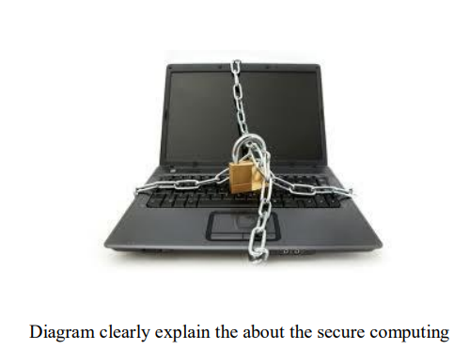
INTRODUCTION
Computer security (Also known as cyber security or IT Security) is information security as applied to computers and networks. The field covers all the processes and mechanisms by which computer-based equipment, information and services are protected from unintended or unauthorized access, change or destruction.

Slide 5
INTRODUCTION
Otherwise, in the computer industry, the term security -- or the phrase computer security -- refers to techniques for ensuring that data stored in a computercannot be read or compromised by any individuals without authorization. Most computer security measures involve data encryption and passwords. Data encryption is the translation of data into a form that is unintelligible without a deciphering mechanism. A password is a secret word or phrase that gives a user access to a particular program or system.

Slide 6
INTRODUCTION
WORKING CONDITIONS AND BASIC NEEDS IN THE SECURE COMPUTING:
Physical address
Access passwords
Prying eye protection
Antivirus software
Firewalls
Software update
Keep secure backups
Report problems

Slide 7
LITERATURE REVIEW
Sl.No. | Name of the Aurthor(s) | Title | Description | Year
1 | J. Tang, C. Aggarwal, and H. Liu | Recommendations in signed social networks | propose a model, RecSSN, to leverage positive and negative links in signed social networks | 2016
2 | V. K. Singh, Q. Huang, and P. K. Atrey | Cyberbullying detection using probabilistic socio-textual information fusion | different classiﬁcation approaches like classical machine learning, RNN, CNN, and pre-trained transformer-based classiﬁers | 2016

Slide 8
LITERATURE REVIEW
Sl.No. | Name of the Aurthor(s) | Title | Description | Year
3 | P. Galán-García, J. G. De La Puerta, C. L. Gómez, I. Santos, and P. G. Bringas | Supervised machine learning for the detection of troll profiles in Twitter social network: Application to a real case of cyberbullying | this approach we also present a successful real life use case in which this methodology was applied to detect and stop a cyberbullying situation in a real elementary school. | 2015
4 | L. Cheng, J. Li, Y. N. Silva, D. L. Hall, and H. Liu | XBully: Cyberbullying detection within a multi-modal context | DEA-RNN model combines Elman type Recurrent Neural Networks (RNN) with an optimized Dolphin Echolocation Algorithm (DEA) for fine-tuning the Elman RNN’s parameters and reducing training time | 2019

Slide 9
SYSTEM ANALYSIS
EXISTING SYSTEM
Xu et al. used textual information to identify emotions in bullying traces, as opposed to determining whether or not a message was bullying.
Singh et al. proposed a probabilistic socio-textual information fusion for cyberbullying detection. This fusion uses social network features derived from a 1.5 ego network and textual features, such as density of bad words and part-of-speech-tags.
Cheng et al. proposed a novel method in identifying cyberbullies within a multimodal context. To understand cyberbullying, Kao et al. proposed a framework by studying social role detection. By using words and comments, temporal characteristics, and social information of a session as well as peer influence

Slide 10
SYSTEM ANALYSIS
DISADVANTAGES OF EXISTING SYSTEM:
Although strict laws exist to punish cyberbullying, there are very less tools available to effectively combat cyberbullying. Social media platforms provide users with the option to self-report abusive behavior and content in addition to providing tools to deal with bullying.
Mining social media networks to determine cyberbullies imposes several challenges and concerns.
Most of the existing system techniques are more manual process that relies on human intervention and decision making
The existing system manually classified them and then differentiate them to simple Naïve classification that uses sentiment analysis as a feature, their results were poor when compared to the manually classified Results.

Slide 11
SYSTEM ANALYSIS
PROPOSED SYSTEM
The objective of our solution is to identify the bullies from raw Twitter data based on the context as well as the contents in which the tweets exist. The aim of the present work is therefore to propose and experimentally evaluate an automated system, called BullyNet, which can able to filter unwanted messages from OSN user walls. We exploit text categorization techniques to automatically predict the bullying messages even with each short text message a set of categories based on its content.
This project will reduce the drawback in the existing system, new software is developed in a user-friendly manner to satisfy and overcome the drawback. The defamation technique monitors every single post happens in this social media and every word will be administered by the automated system. Natural language processing technique combined with keyword matching algorithm ensures identifying defamed profiles and odd out and list them to admin user. In addition the admin has also have the option of blocking the user who makes cyberbulling.

Slide 12
SYSTEM ANALYSIS
ADVANTAGES OF PROPOSED SYSTEM:
The proposed system shows us a Good accuracy which is better than existing systems. Our model will help people from the attacks of social media bullies.
The proposed system instead of simply looking for patterns, and finding the bullies, it also has the option of block the bullies.
The proposed system results will be more precise as compared to existing system.

Slide 13
SYSTEM ANALYSIS
HARDWARE REQUIREMENTS:
System : Pentium i3 Processor
Hard Disk : 500 GB.
Monitor : 15’’ LED
Input Devices : Keyboard, Mouse
Ram : 2 GB

Slide 14
SYSTEM ANALYSIS
SOFTWARE REQUIREMENTS:
Operating system : Windows 10.
Coding Language : JAVA.
Tool : Netbeans 8.2
Database : MYSQ

Slide 15
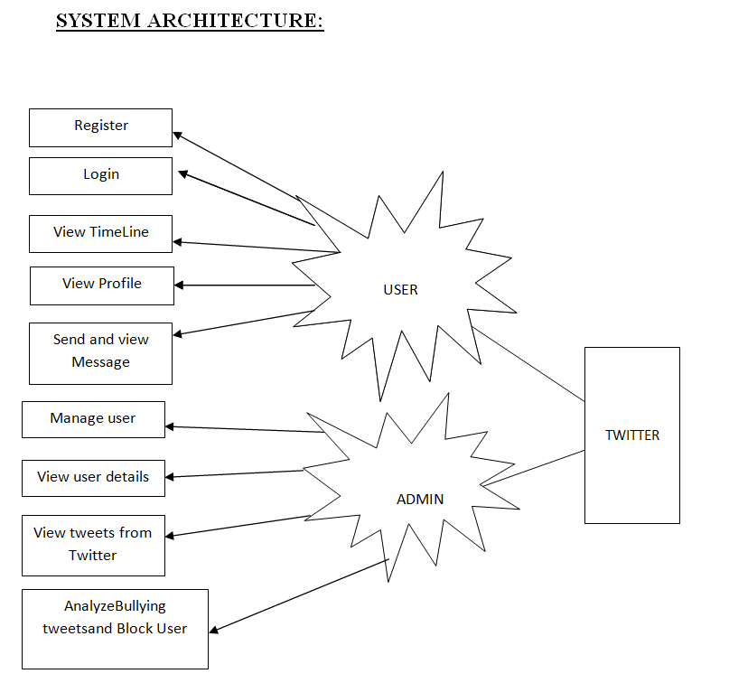
STSTEM DESIGN

Slide 16
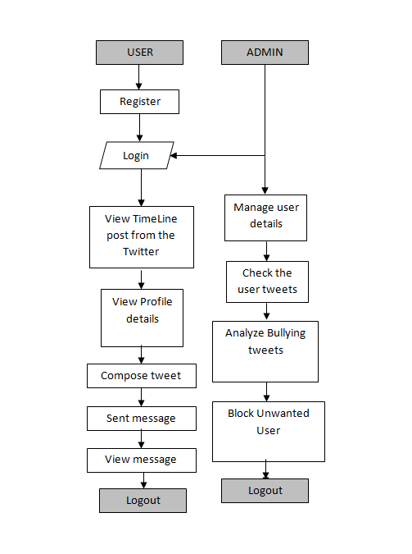
DATAFLOW DIAGRAM

Slide 17
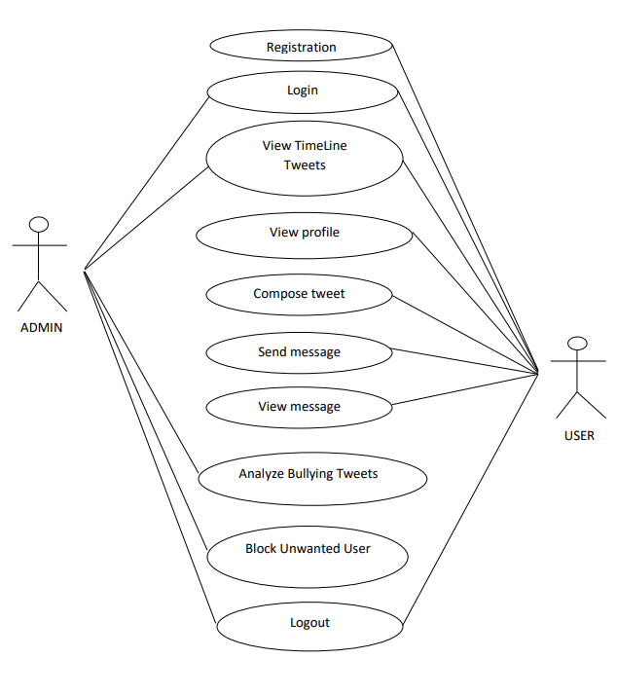
USECASE DIAGRAMS

Slide 18
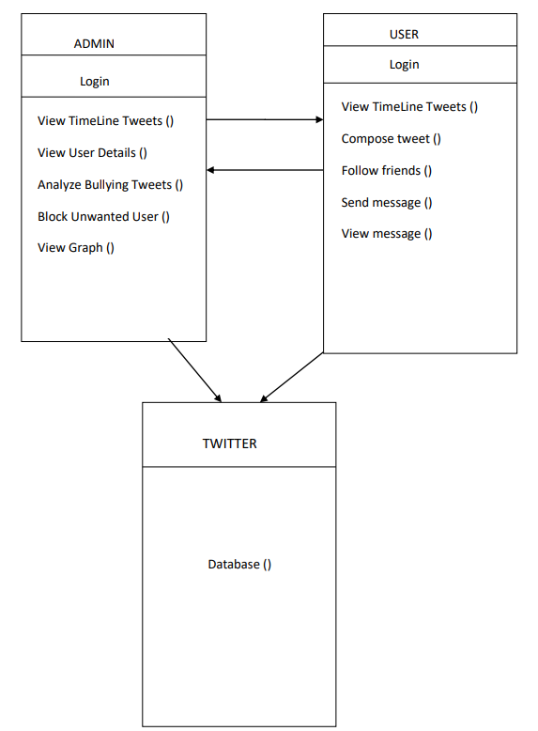
CLASS DIAGRAMS

Slide 19
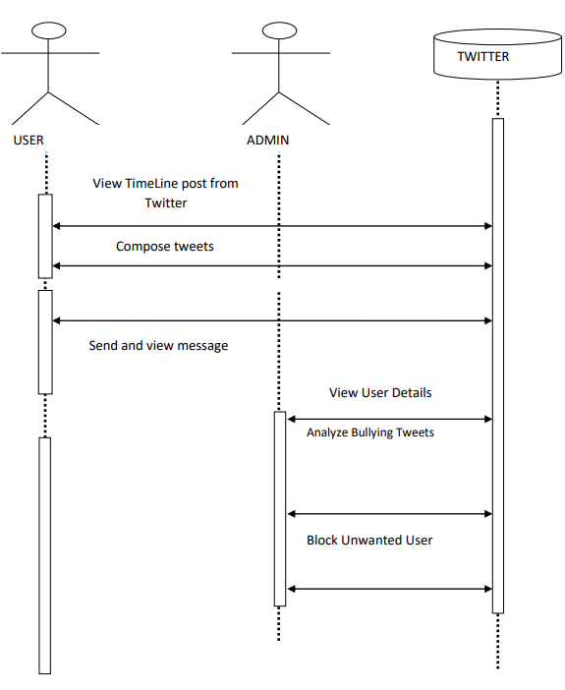
SEQUENCE DIAGRAM

Slide 20
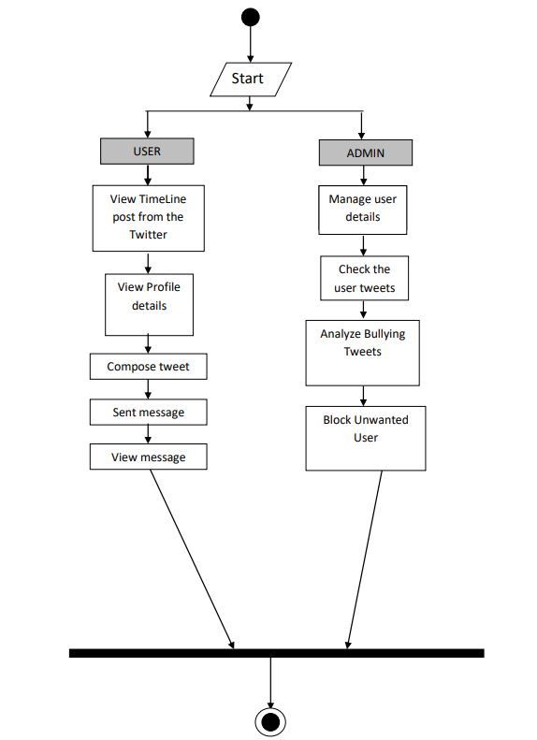
ACTIVITY DIAGRAMS

Slide 21
MODULES
MODULES:
OSN System Construction Module
Filtering process module
Online setup assistant module
Blocking process Admin module

Slide 22
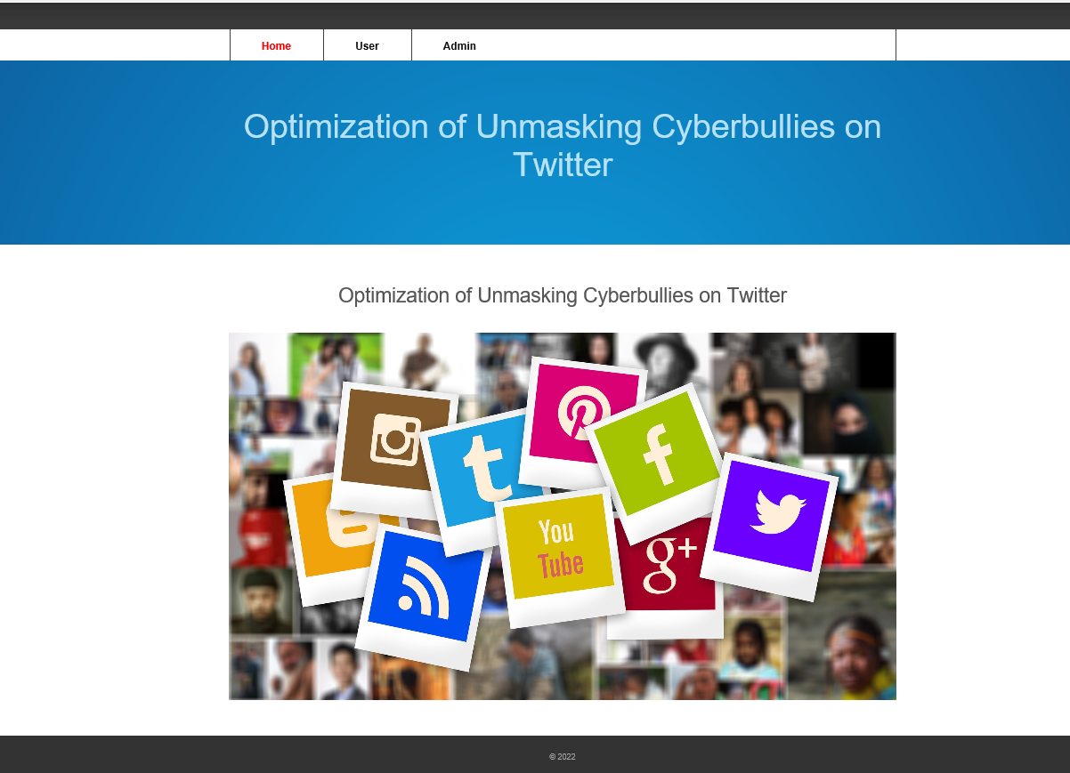
Screenshots
HOME PAGE

Slide 23
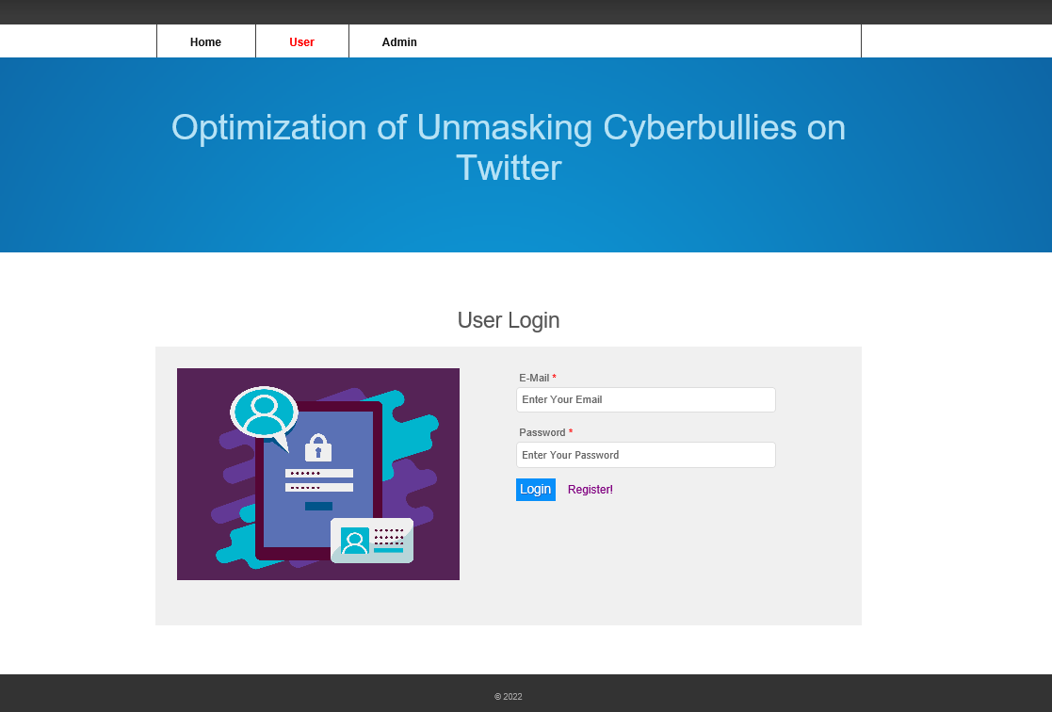
Screenshots
USER LOGIN PAGE

Slide 24
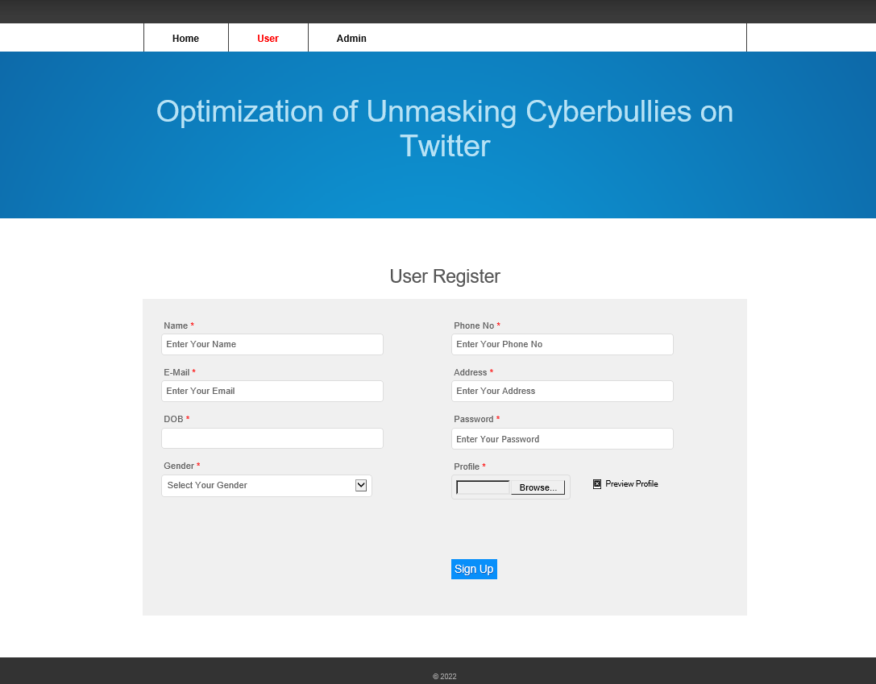
Screenshots
USER REGISTRATION PAGE

Slide 25
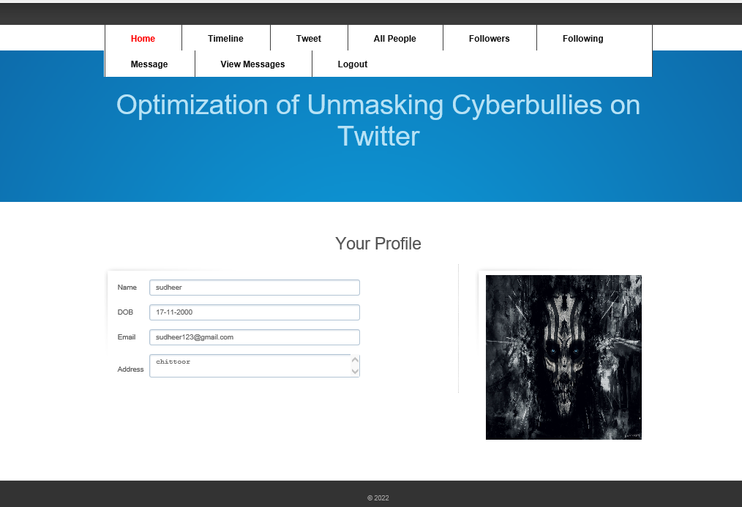
Screenshots
USER HOME SCREEN

Slide 26
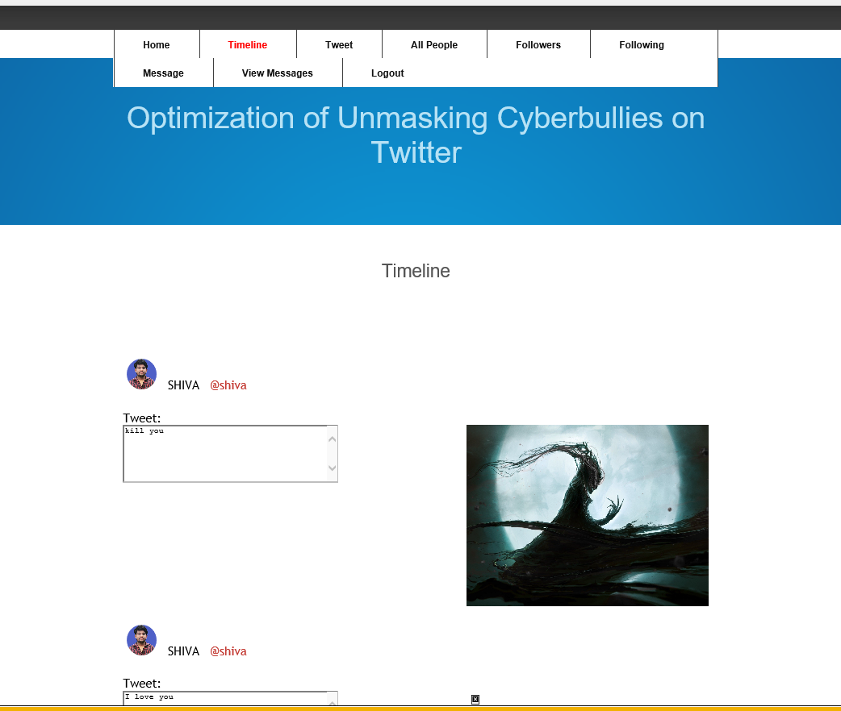
Screenshots
TIMELINE

Slide 27
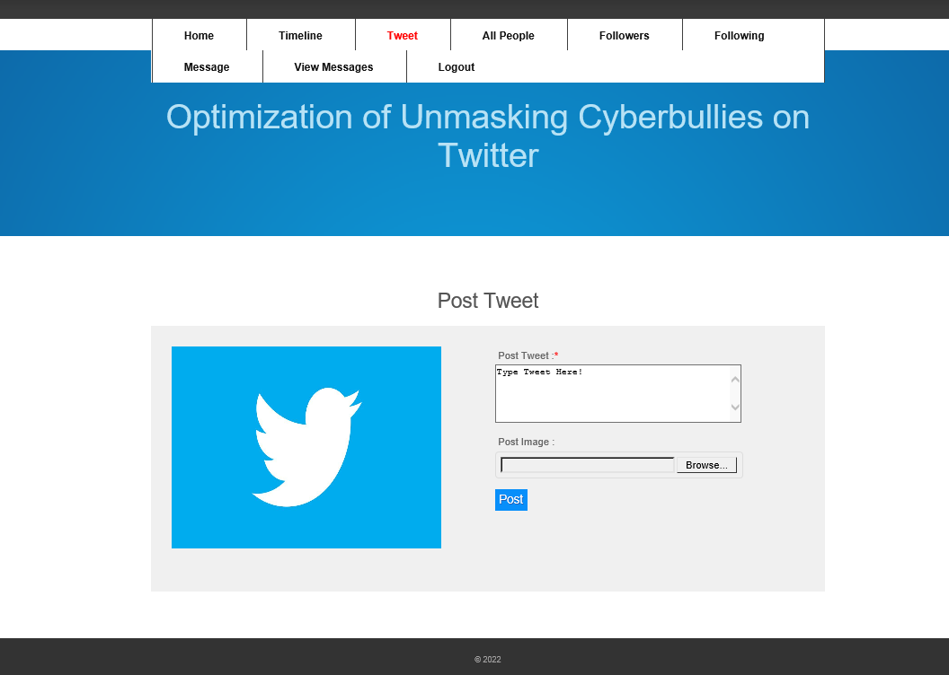
Screenshots
TWEETS

Slide 28
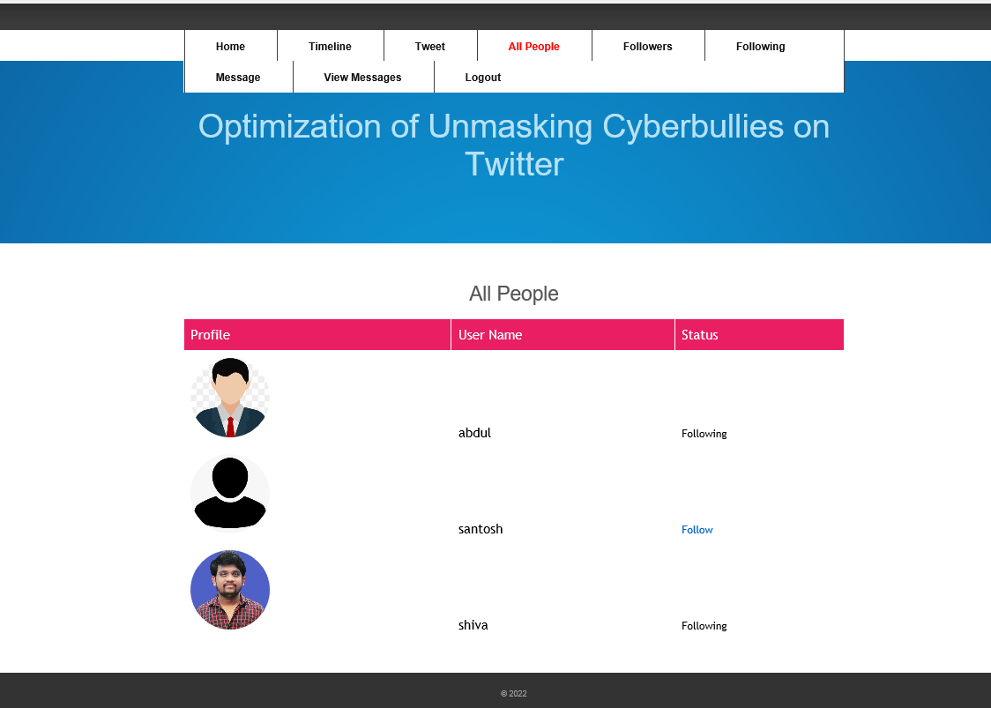
Screenshots
ALL PEOPLE

Slide 29
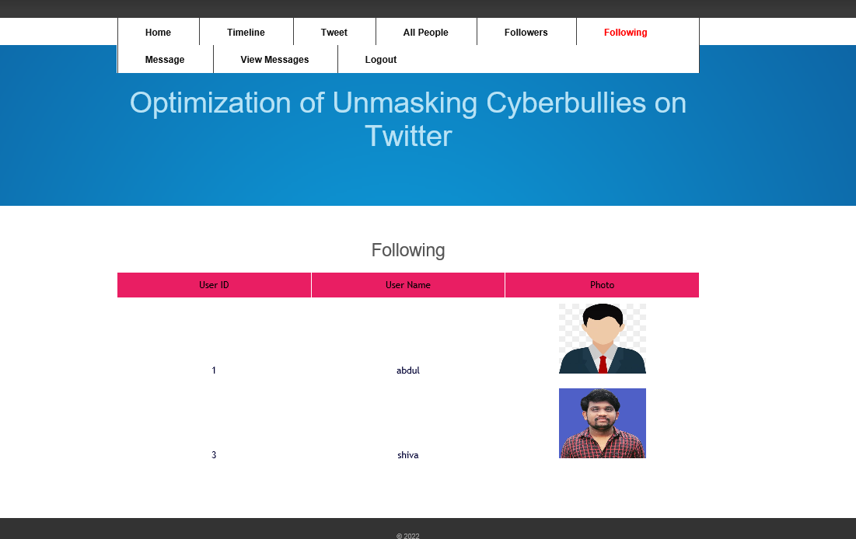
Screenshots
FOLLOWING

Slide 30
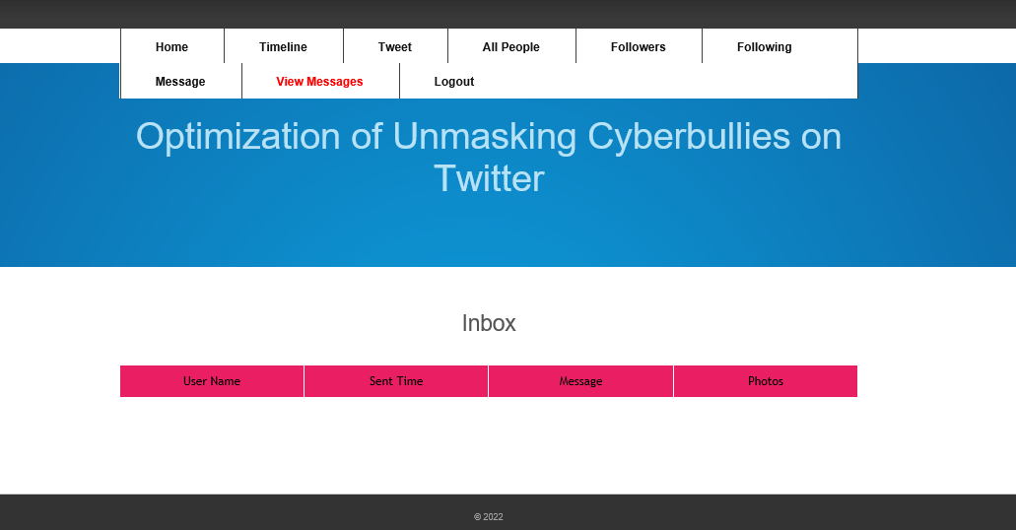
Screenshots
VIEW MESSAGES

Slide 31
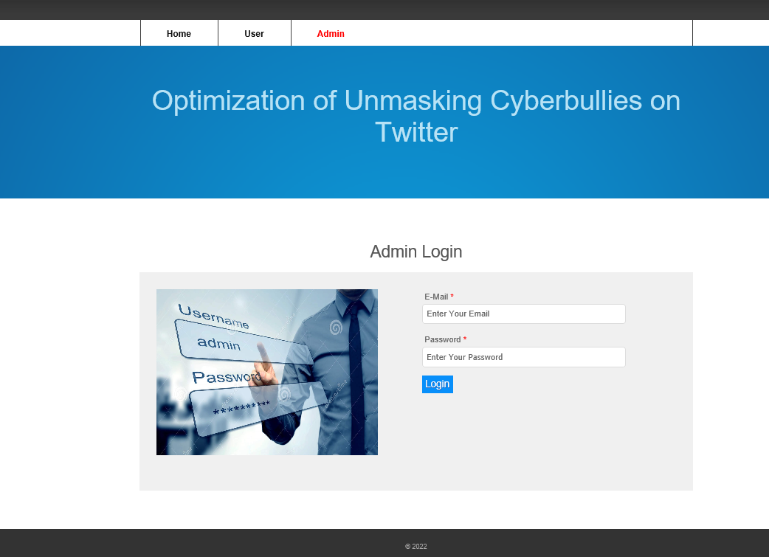
Screenshots
ADMIN LOGIN

Slide 32
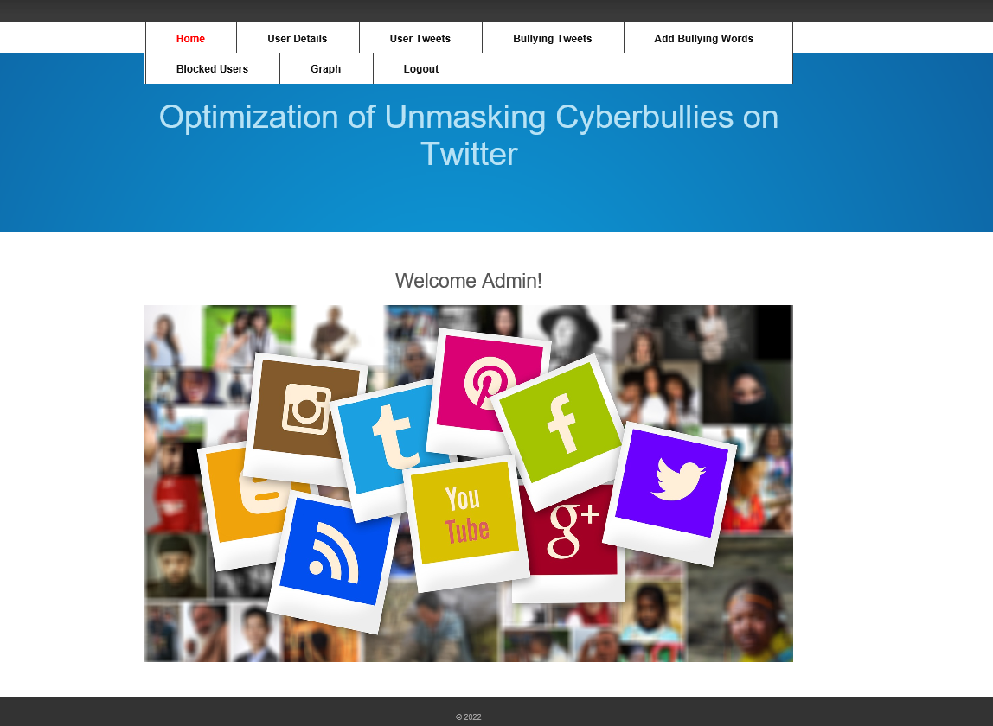
Screenshots
ADMIN HOME SCREEN PAGE

Slide 33
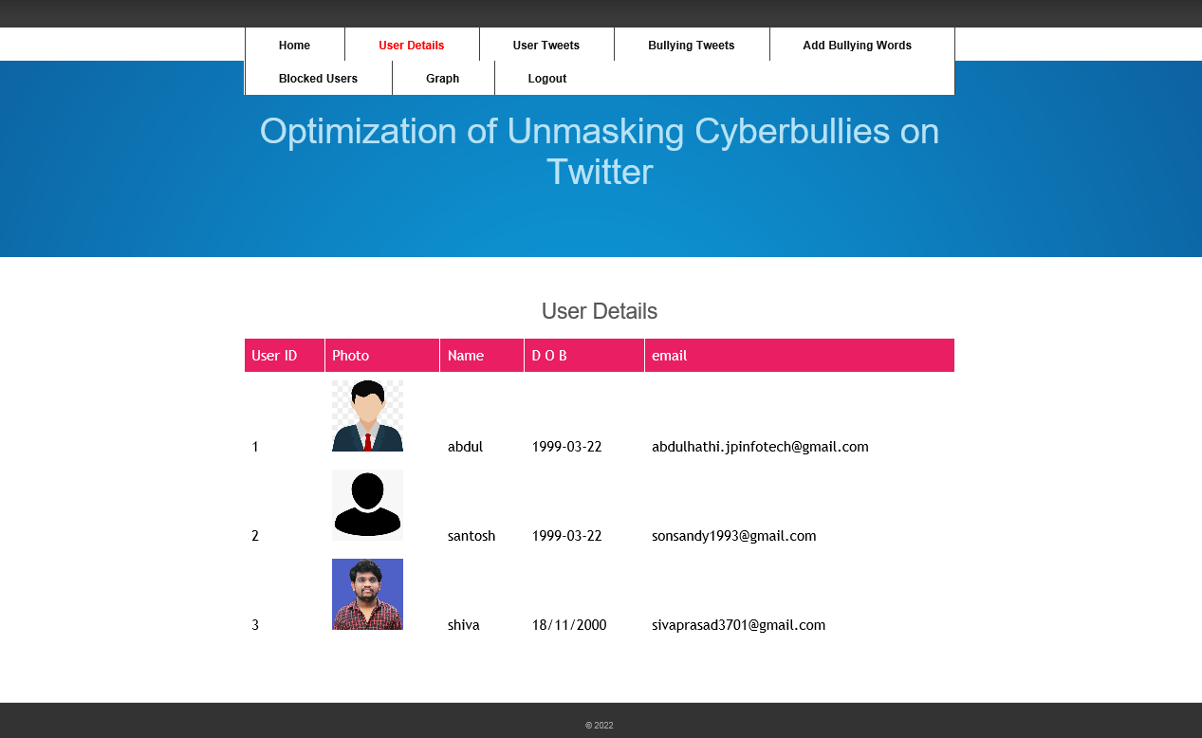
Screenshots
USER DETAILS

Slide 34
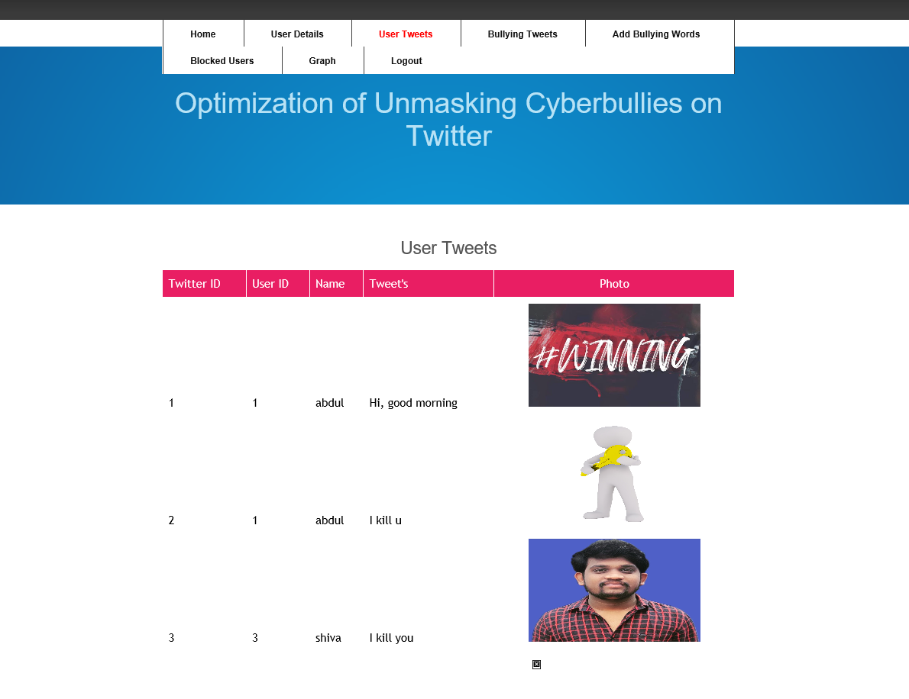
Screenshots
USER TWEETS

Slide 35
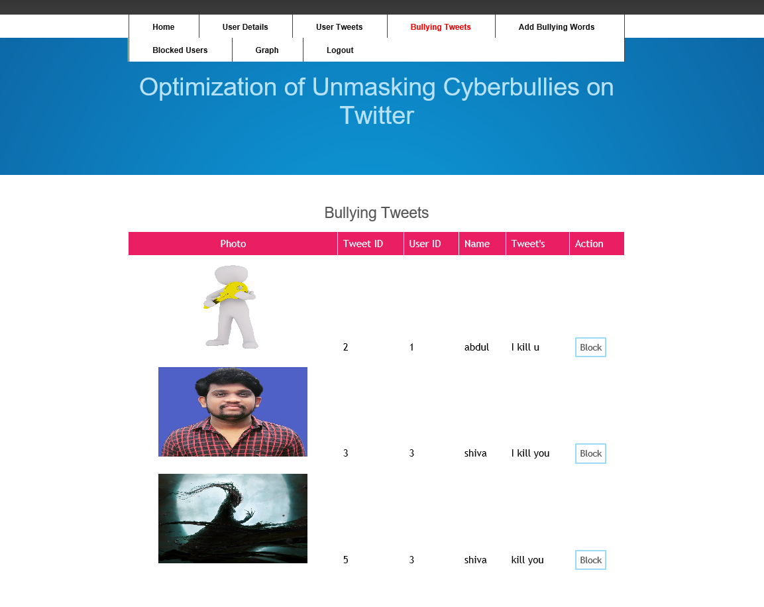
Screenshots
BULLING TWEETS

Slide 36
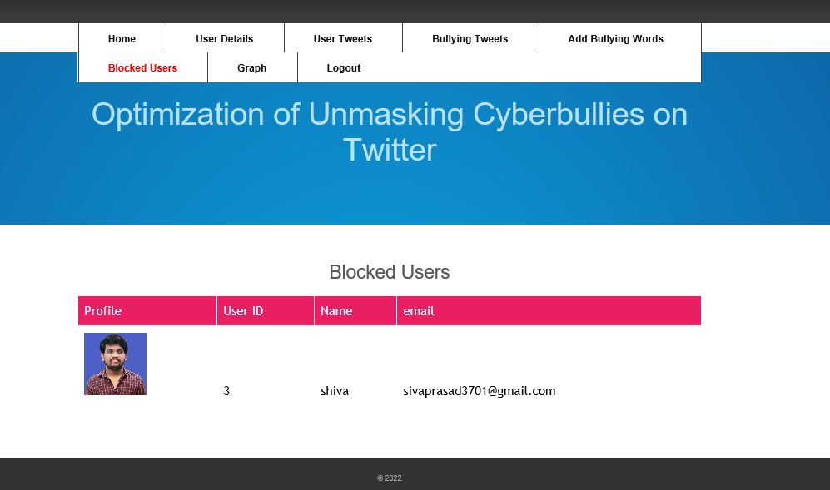
Screenshots
BLOCKED USERS

Slide 37
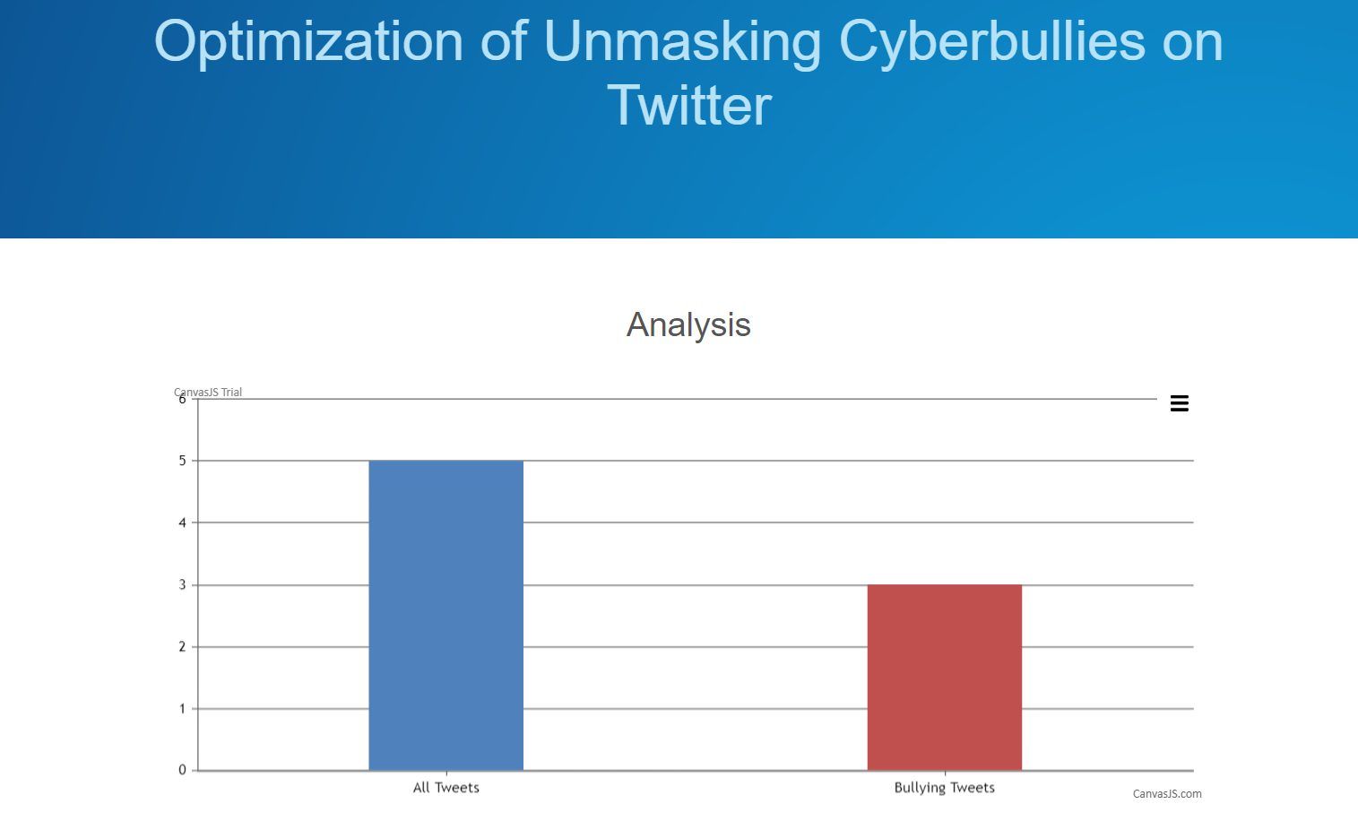
Screenshots
GRAPH

Slide 38
FUTURE WORK
There are still several open questions deserving furtherinvestigation. First, our approach focuses on extracting emotionsand behavior from texts and emojis in tweets. However,it would be interesting to investigate images and videos,given that many users use them to bully others. Second,it does not distinguish between bully and aggressive users.Devising new algorithms or techniques to distinguish bulliesfrom aggressors would prove critical in better identificationof cyberbullies. Another topic of interest would be to studythe relationship between conversation graph dynamics andgeographic location and how these dynamics are affected bythe geographic dispersion of the users? Are the proximityincrease the bullying behavior?

Slide 39
Conclusion
Although the digital revolution and the rise of social mediaenabled great advances in communication platforms and socialinteractions, a wider proliferation of harmful behavior knownas bullying has also emerged. This article presents a novelframework of BullyNet to identify bully users from the Twittersocial network. We performed extensive research on miningSNs for better understanding of the relationships betweenusers in social media, to build an SN based on bullyingtendencies. We observed that by constructing conversationsbased on the context as well as content, we could effectivelyidentify the emotions and the behavior behind bullying. In ourexperimental study, the evaluation of our proposed centralitymeasures to detect bullies from SN, and we achieved good accuracy in identifying bullies forvarious cases.

Slide 40
References
[1] J. Tang, C. Aggarwal, and H. Liu, “Recommendations in signed socialnetworks,” in Proc. 25th Int. Conf. World Wide Web, Apr. 2016,pp. 31–40.
[2] D. Liben-Nowell and J. Kleinberg, “The link-prediction problem forsocial networks,” J. Amer. Soc. Inf. Sci. Technol., vol. 58, no. 7,pp. 1019–1031, 2007.
[3] U. Brandes and D. Wagner, “Analysis and visualization of socialnetworks,” in Graph Drawing Software. Amsterdam, The Netherlands:Elsevier, 2004, pp. 321–340.
[4] X. Hu, J. Tang, H. Gao, and H. Liu, “Social spammer detectionwith sentiment information,” in Proc. IEEE Int. Conf. Data Mining,Dec. 2014, pp. 180–189.
[5] E. E. Buckels, P. D. Trapnell, and D. L. Paulhus, Trolls Just Want toHave Fun. Springer, 2014, pp. 67:97–102

